Slide 1

ECE 281 Lesson 22
1

Slide 2
Lesson 22 Outline
Do Time Logs!
CE4 – Elevator Control Due COB LSN 23!
Setup/Hold Time Constraints
Hold Time Violation
Clock Skew
Synchronizers

Slide 3
Simplicity / Beauty of Digital
Analog is messy
I/O varies continuously
I/O can change at any time
Digital
Discrete, “simple”, and robust

Slide 4
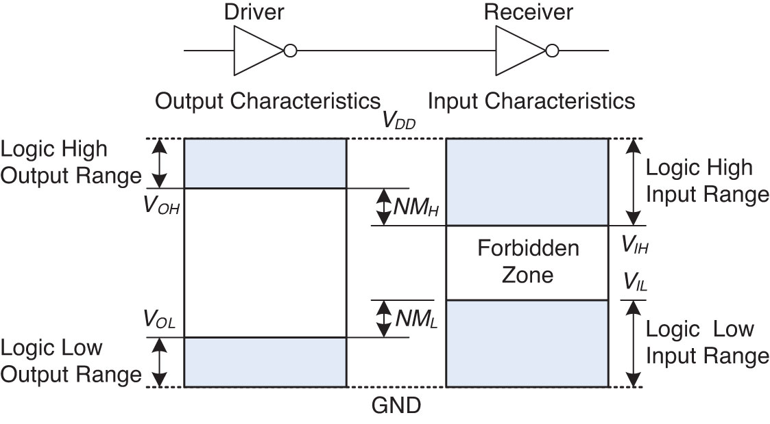
Static Discipline → 0’s and 1’s
Figure 1.23 Logic levels and noise margins

Slide 5
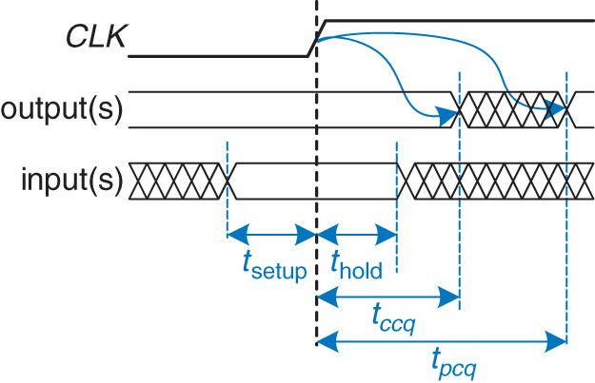
Dynamic Discipline → break time into clock cycles
We will define all of these terms in a minute
We are going to define a window (aperture) around the clock signal where we don’t want things to change

Slide 6
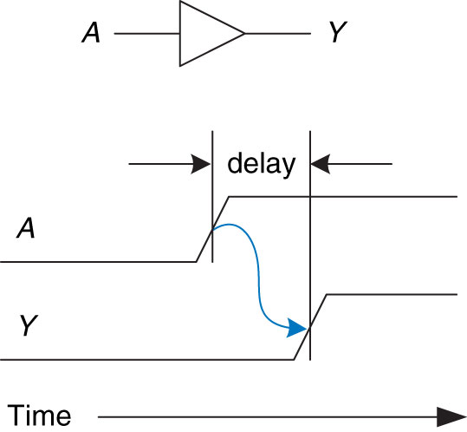
Delay
Review
Figure 2.66 Circuit delay
Copyright © 2013 Elsevier Inc. All rights reserved.

Slide 7
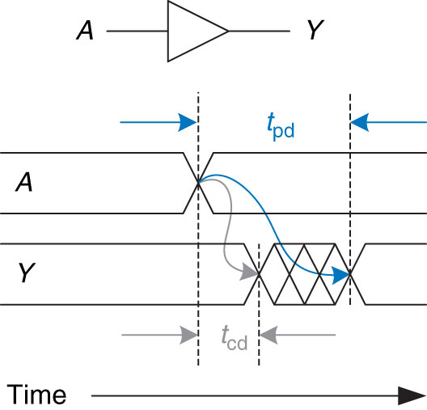
Propagation Delay and Contamination Delay
Review
Figure 2.67 Propagation and contamination delay
Copyright © 2013 Elsevier Inc. All rights reserved.

Slide 8
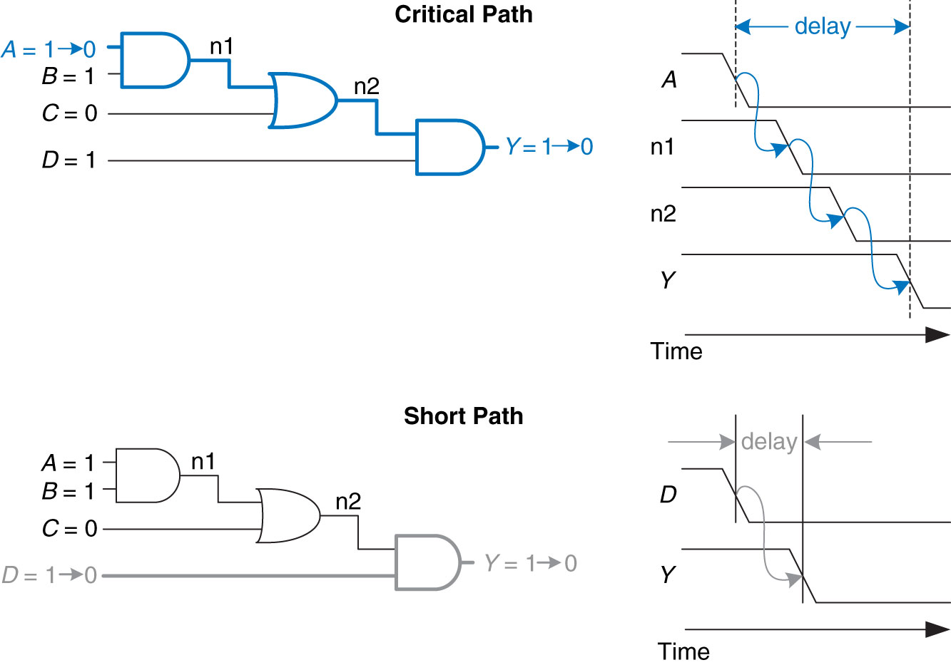
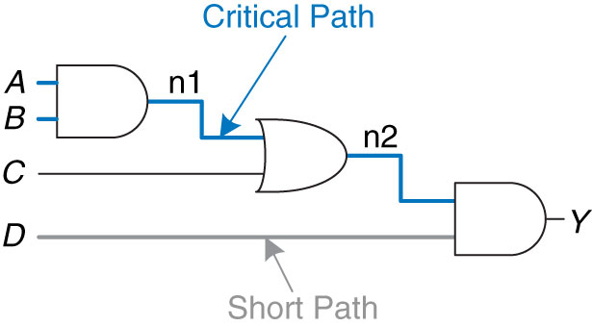
Critical Path and Shortest Path Waveform
Review

Slide 9
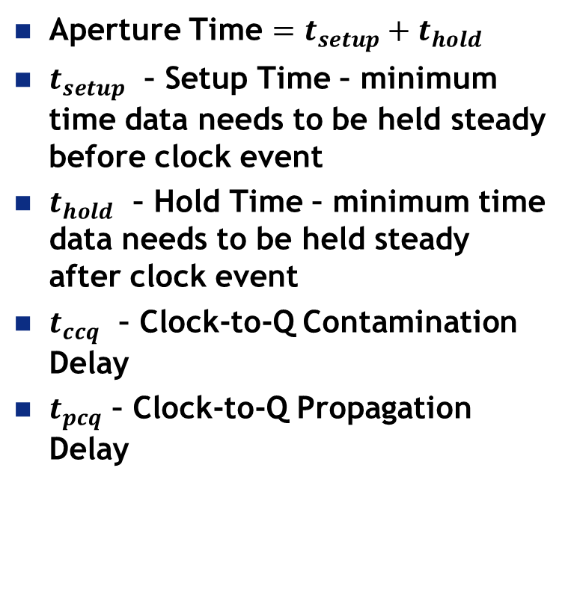
Timing Vocabulary and Equations
Aperture Time $=t_{setup}+t_{hold}$
$t_{setup}$ – Setup Time – minimum time data needs to be held steady before clock event
$t_{hold}$ – Hold Time – minimum time data needs to be held steady after clock event
$t_{ccq}$ – Clock-to-Q Contamination Delay
$t_{pcq}$ – Clock-to-Q Propagation Delay

Slide 10
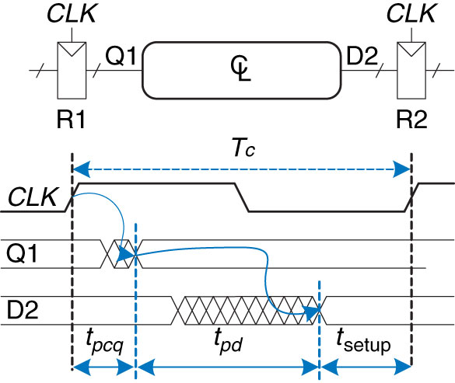

Timing Vocabulary and Equations
$T_{c}$ – Clock Period ➔ Frequency = $\frac{1}{T_{c}}=f_{c}$
$$T_{c} ≥t_{pcq}+t_{pd}+t_{setup}$$
This is propagation delay for whole CL

Slide 11
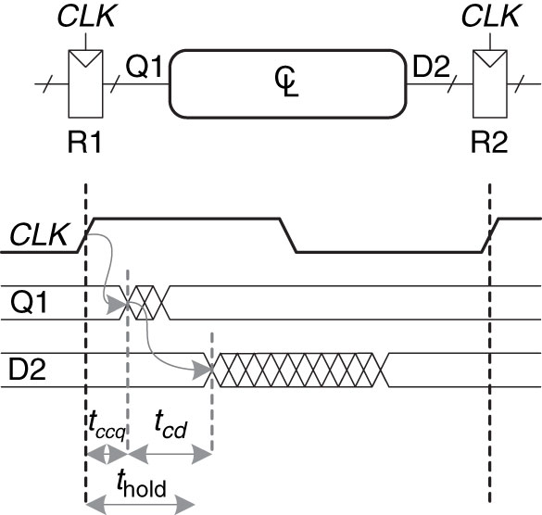
Time Clock to Q
Contamination Delay
Figure 3.40 Minimum delay for hold time constraint

Slide 12

Setup/Hold Time Constraints
Given:
$$T_{c} ≥t_{pcq}+t_{pd}+t_{setup}$$
Hold Time Constraints:
$$t_{cd} ≥t_{hold}−t_{ccq}$$
Setup Time Constraints:
$$t_{pd} ≤T_{c}−\left(t_{pcq}+t_{setup}\right)$$
Sequencing Overhead

Slide 13
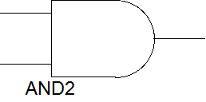
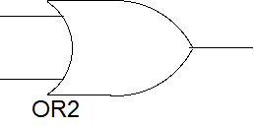
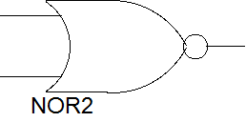
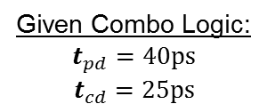
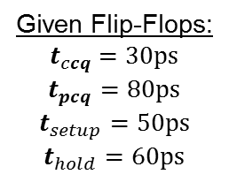
Example 3.10 –Timing Analysis
CLK
A
N1
CLK
X*
X
B
C
Y*
Y
Given Flip-Flops:
$$t_{ccq}=30ps$$
$$t_{pcq}=80ps$$
$$t_{setup}=50ps$$
$$t_{hold}=60ps$$
Given Combo Logic:
$$t_{pd}=40ps$$
$$t_{cd}=25ps$$
D
1. Determine Maximum clock frequency and whether any hold time violations occur

Slide 14
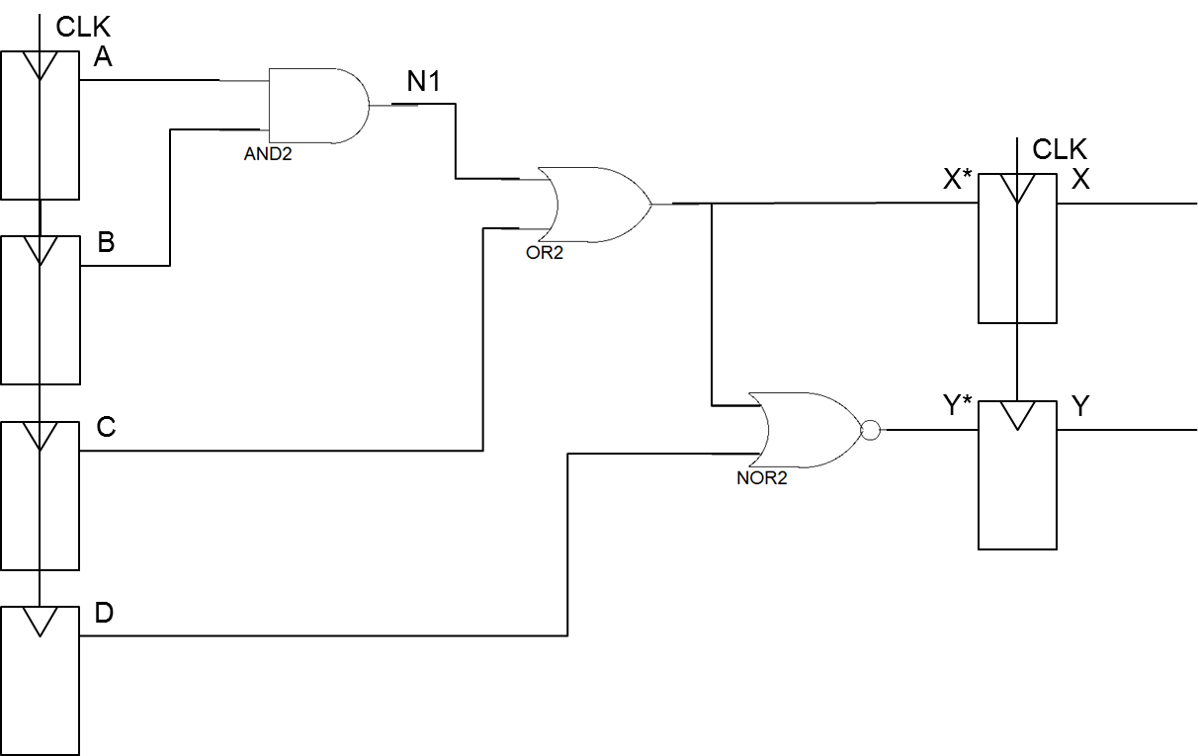
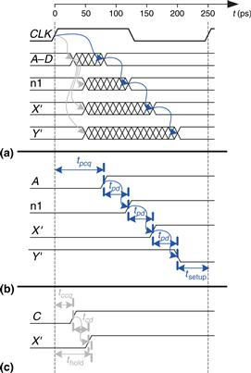


Example 3.10 –Timing Analysis
Find max clock frequency?
Critical Path
$T_{c} ≥t_{pcq}+3∙t_{pd}+t_{setup}$
min $T_{c} ≥80+3∙40+50$ = 250ps
max $f_{c}=\frac{1}{T_{c}}=\frac{1}{250ps}=$
0→1
0
0→1
0→1
1
1→0
0
0
$$4 GHz$$
Figure 3.43 Timing diagram: (a) general case, (b) critical path,
(c) short path

Slide 15


Example 3.10 –Timing Analysis
Hold time violation occur?
Shortest Path
$Shortest Path=t_{ccq}+t_{cd}$
$Shortest Path=30+25=55ps$
We assumed $t_{hold}=60ps$ (i.e. hold time violation)
0
0
0→1
1
1→0
0→1
could add buffers to fix Hold Time violation
0
Figure 3.43 Timing diagram: (a) general case, (b) critical path,
(c) short path

Slide 16
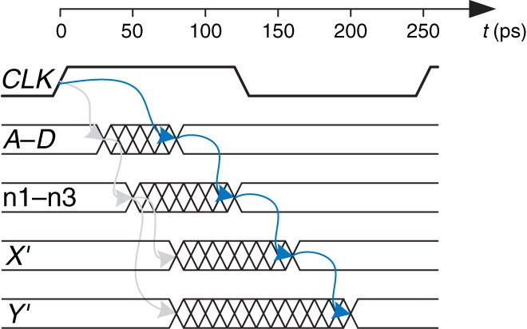

Example 3.10 –Timing Analysis
Fix hold time violation
Add Buffers to Shortest Path
$Shortest Path=t_{ccq}+2∙t_{cd}$
$Shortest Path=30+2∙25=80ps$
could add buffers to fix Hold Time violation
Figure 3.45 Timing diagram with buffers to fix hold time problem

Slide 17
Timing Diagram with Buffers to fix Hold Time Problem
Figure 3.45 Timing diagram with buffers to fix hold time problem
Copyright © 2013 Elsevier Inc. All rights reserved.

Slide 18
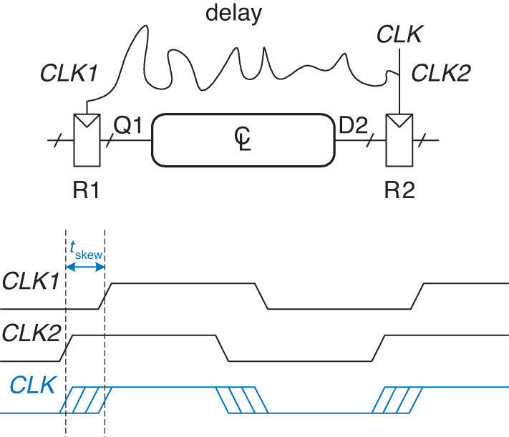
Clock Skew
Figure 3.46 Clock skew caused by wire delay
Copyright © 2013 Elsevier Inc. All rights reserved.

Slide 19
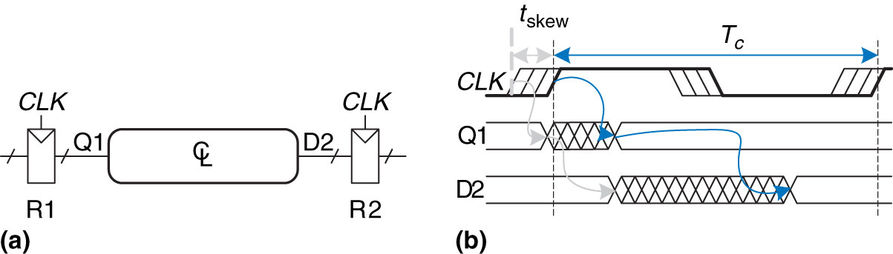

Clock Skew - Timing
Timing with Clock Skew:
$$T_{c} ≥t_{pcq}+t_{pd}+t_{setup}+t_{skew}$$
Figure 3.47 Timing diagram with clock skew
Copyright © 2013 Elsevier Inc. All rights reserved.

Slide 20
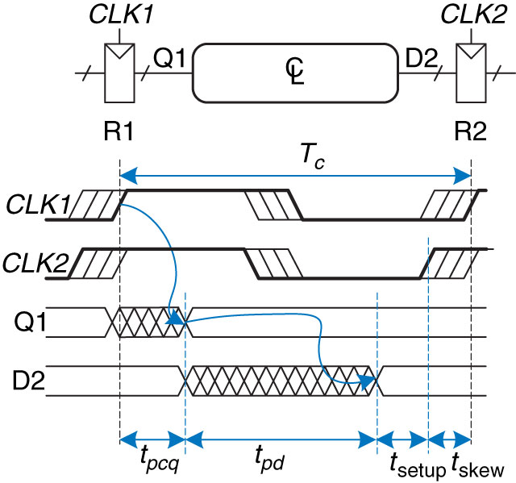

Clock Skew – Setup Time
Setup Time Constraints with Skew :
$$t_{pd} ≤T_{c}−\left(t_{pcq}+t_{setup}+t_{skew}\right)$$
Figure 3.48 Setup time constraint with clock skew
Copyright © 2013 Elsevier Inc. All rights reserved.

Slide 21
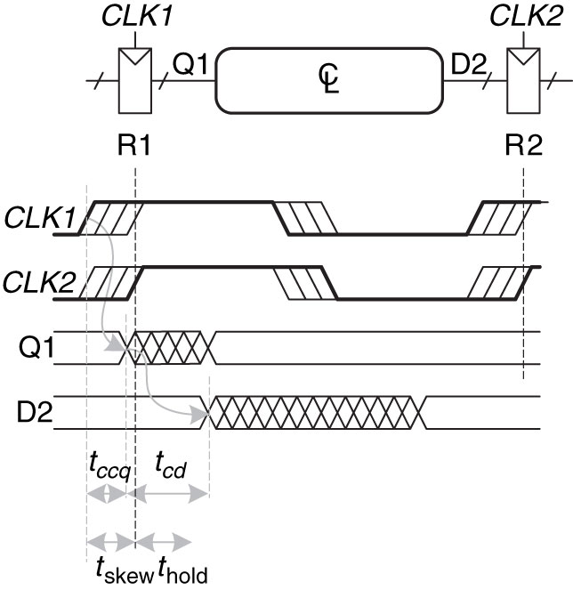

Clock Skew – Hold Time
Hold Time Constraints with Skew:
$$t_{cd} ≥t_{hold}+t_{skew}−t_{ccq}$$
Figure 3.49 Hold time constraint with clock skew
Copyright © 2013 Elsevier Inc. All rights reserved.

Slide 22
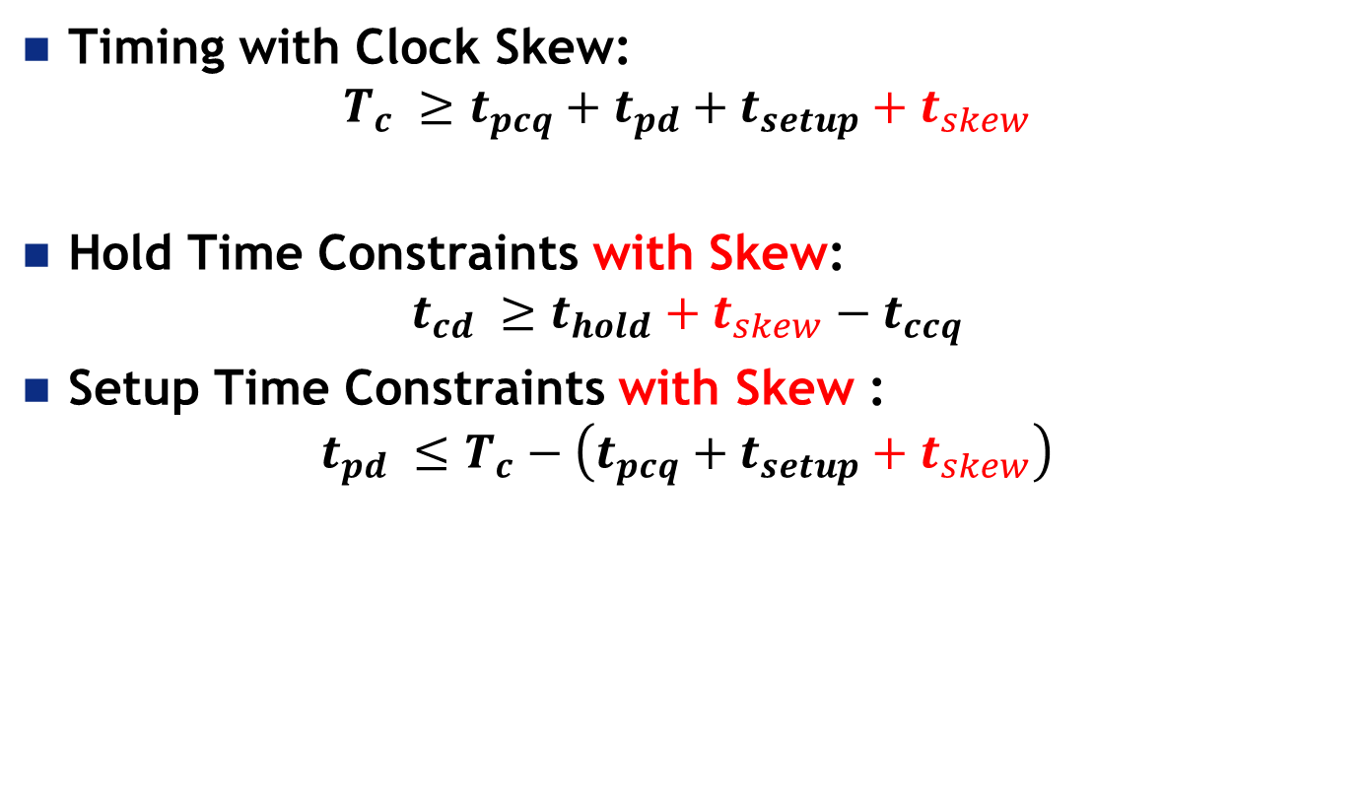
Clock Skew - Summary
Timing with Clock Skew:
$$T_{c} ≥t_{pcq}+t_{pd}+t_{setup}+t_{skew}$$
Hold Time Constraints with Skew:
$$t_{cd} ≥t_{hold}+t_{skew}−t_{ccq}$$
Setup Time Constraints with Skew :
$$t_{pd} ≤T_{c}−\left(t_{pcq}+t_{setup}+t_{skew}\right)$$
Sequencing Overhead

Slide 23
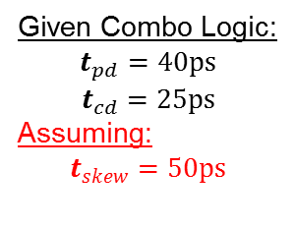
Example 3.10 –Timing Analysis with clock skew
CLK
A
N1
CLK
X*
X
B
C
Y*
Y
Given Flip-Flops:
$$t_{ccq}=30ps$$
$$t_{pcq}=80ps$$
$$t_{setup}=50ps$$
$$t_{hold}=60ps$$
Given Combo Logic:
$$t_{pd}=40ps$$
$$t_{cd}=25ps$$
Assuming:
$$t_{skew}=50ps$$
D

Slide 24


Example 3.10 –Timing Analysis with clock skew
Find max clock frequency?
Critical Path
$T_{c} ≥t_{pcq}+3∙t_{pd}+t_{setup}+t_{skew}$
${min T}_{c} ≥80+3∙40+50+50$ = 300ps
max $f_{c}=\frac{1}{T_{c}}=\frac{1}{250ps}=$
$$3.3 GHz$$
Figure 3.43 Timing diagram: (a) general case, (b) critical path,
(c) short path

Slide 25
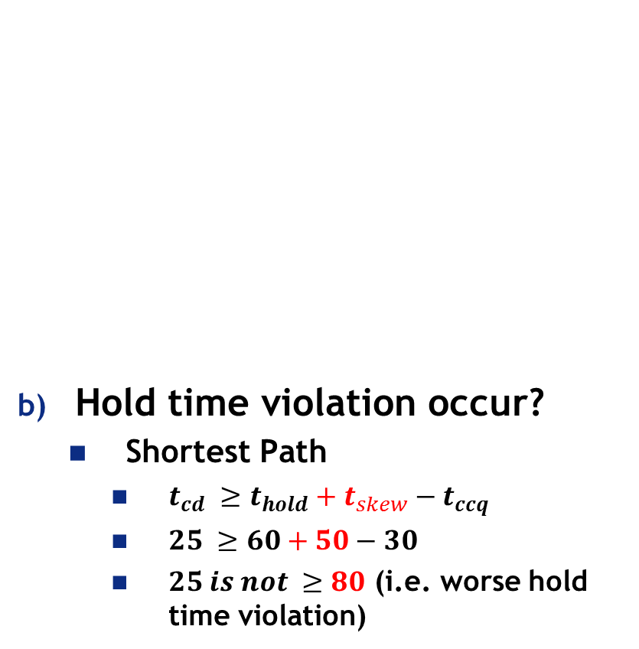
Example 3.10 –Timing Analysis with clock skew
Hold time violation occur?
Shortest Path
$t_{cd} ≥t_{hold}+t_{skew}−t_{ccq}$
$25 ≥60+50−30$
$25 is not ≥80$ (i.e. worse hold time violation)
could add buffers to fix Hold Time violation
Figure 3.43 Timing diagram: (a) general case, (b) critical path,
(c) short path

Slide 26
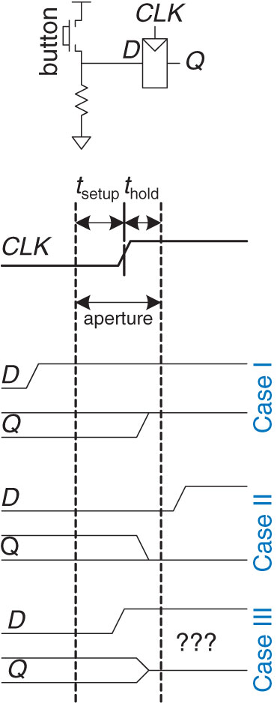
Aperture
Figure 3.50 Input changing before, after, or during aperture
Copyright © 2013 Elsevier Inc. All rights reserved.

Slide 27
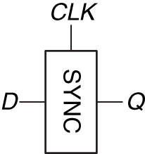

Synchronizers
Slows down inputs and gives them time to settle/stabilize – Resolution Time ($t_{res}$)
$$t_{res} >T_{c}−t_{setup}$$
To guarantee good logic levels all asynchronous inputs should be passed through synchronizers
Figure 3.52 Synchronizer symbol

Slide 28
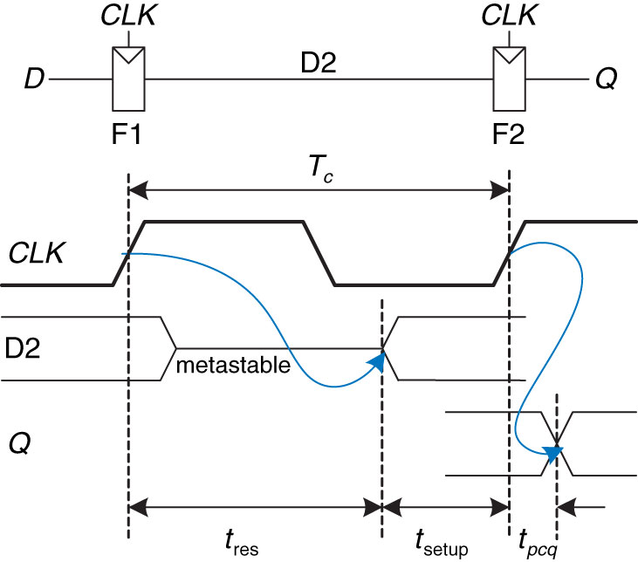
Synchronizers
Figure 3.53 Simple synchronizer
Copyright © 2013 Elsevier Inc. All rights reserved.

Slide 29

29

Slide 30
Critical Path and Shortest Path
Figure 2.68 Short path and critical path

Slide 31
Timing Specification for Synchronous Circuits
Figure 3.37 Timing specification for synchronous sequential circuit
Copyright © 2013 Elsevier Inc. All rights reserved.

Slide 32
Time Clock to Q
Propagation Delay
Figure 3.39 Maximum delay for setup time constraint

Slide 33
Example 3.10 –Timing Analysis
Find max clock frequency?
Critical Path
$T_{c} ≥t_{pcq}+3∙t_{pd}+t_{setup}$
min $T_{c} ≥80+3∙40+50$ = 250ps
max $f_{c}=\frac{1}{T_{c}}=\frac{1}{250ps}=$
0→1
0
0→1
0→1
1
1→0
0
0
$$4 GHz$$
Figure 3.43 Timing diagram: (a) general case, (b) critical path,
(c) short path

